Slide 1
Guitar
Reading Tabs

Slide 2
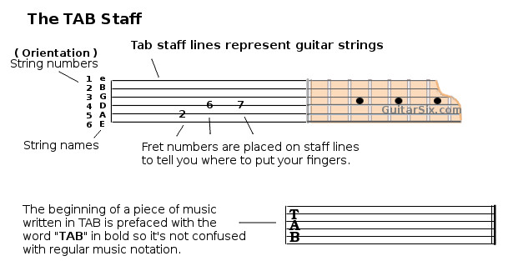

Slide 3
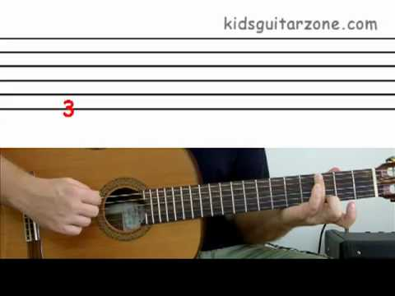
Reading Tablature

Slide 4
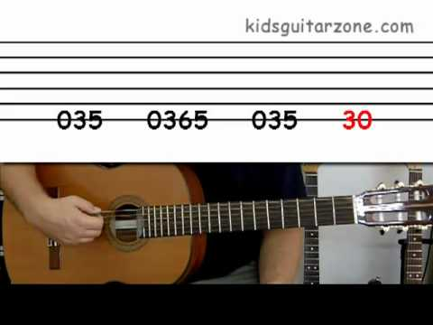
Smoke on the Water

Slide 5
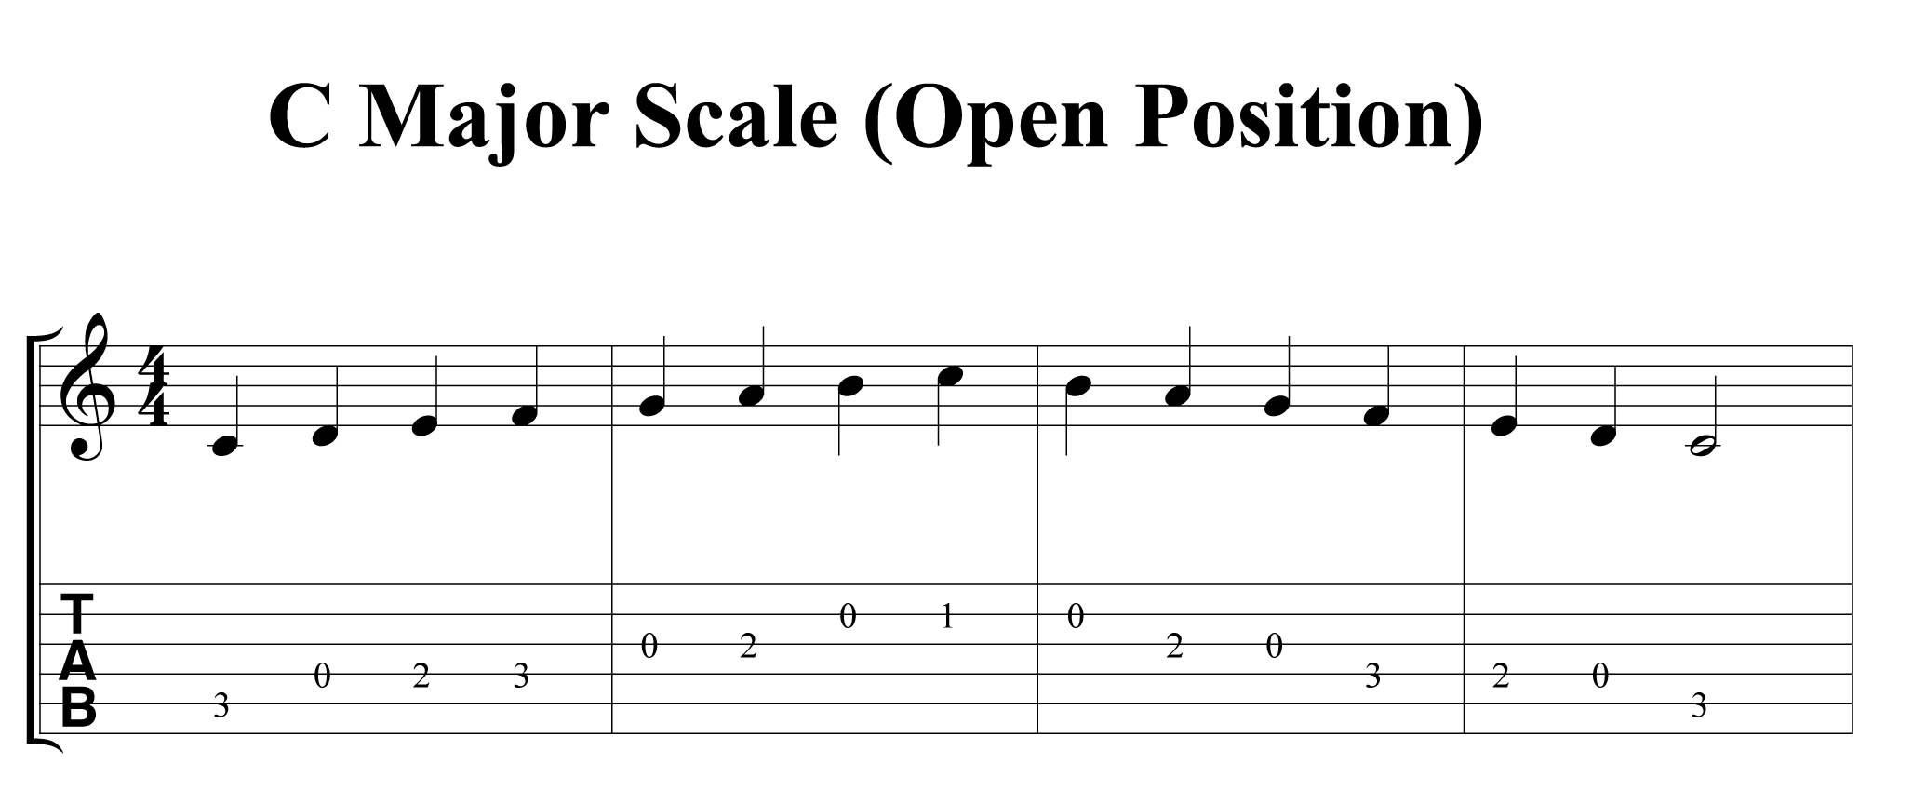
Tabs and Standard Notation – C Major Scale

