Slide 1
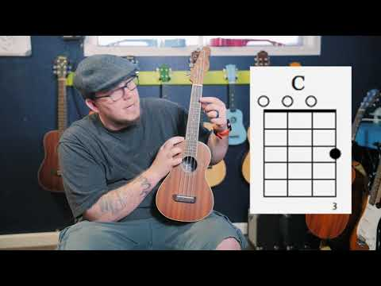
2019 Uku - Chord - how to read
Notes:
https://www.youtube.com/watch?v=AlncLO5bunI

Slide 2
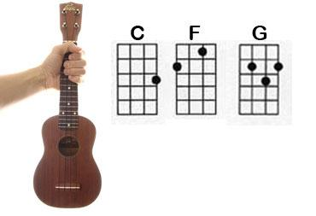
C Chord
Third finger
In the Third Fret
On the String closest to our toes (A String)
3

Slide 3
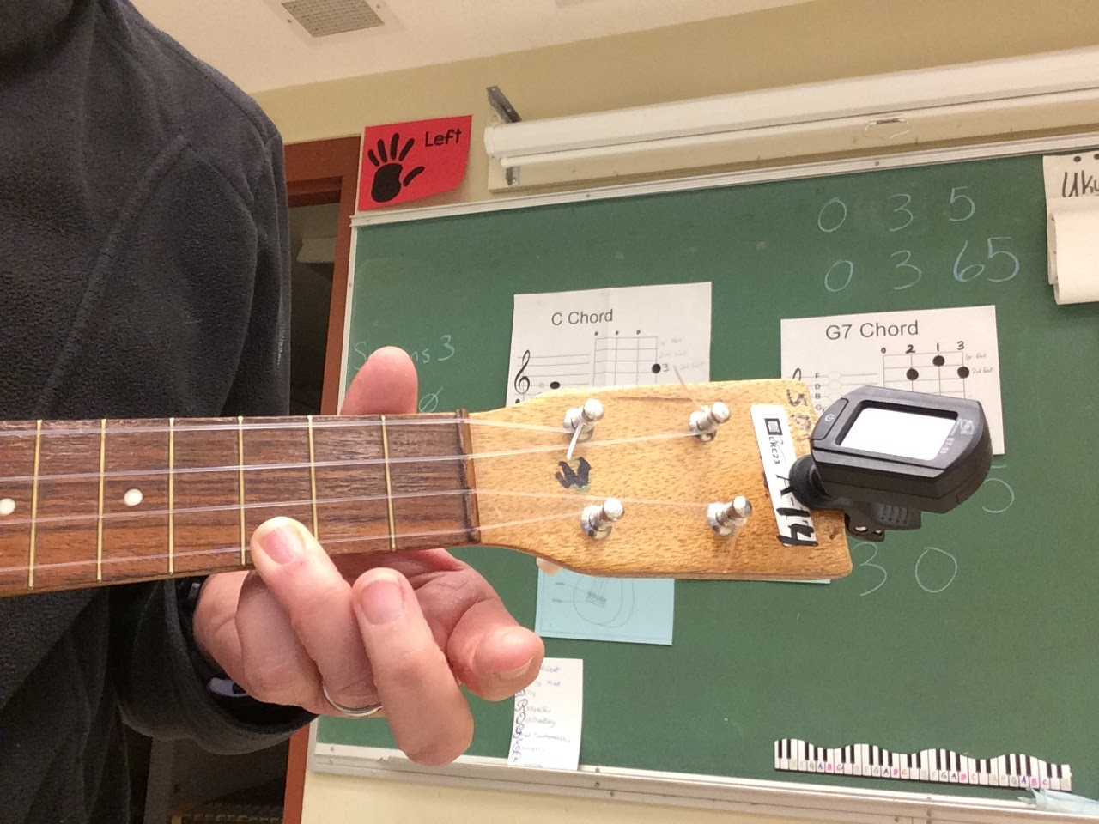
C

Slide 4
F Chord
2
1
1st finger
In the 1st Fret
On the String second from the bottom (E String)
2nd finger
In the 2nd Fret
On the top string (G String)

Slide 5
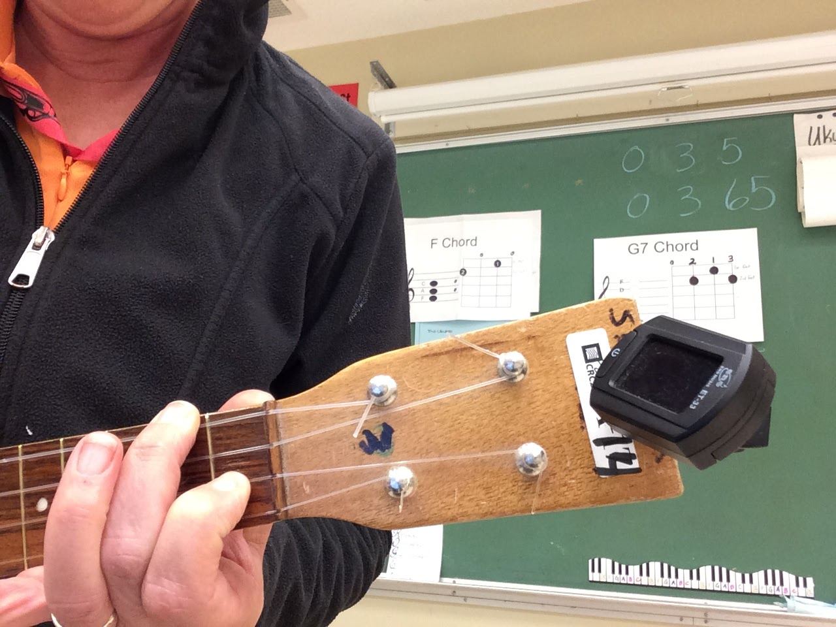
F

Slide 6
G Chord
1
3
2
1st finger
In the 2nd Fret
On the String second from the top (C String)
3rd finger
In the 3rd Fret
On the string second from the bottom (E String)
2nd finger
In the 2nd Fret
On the bottom string (A String)

Slide 7
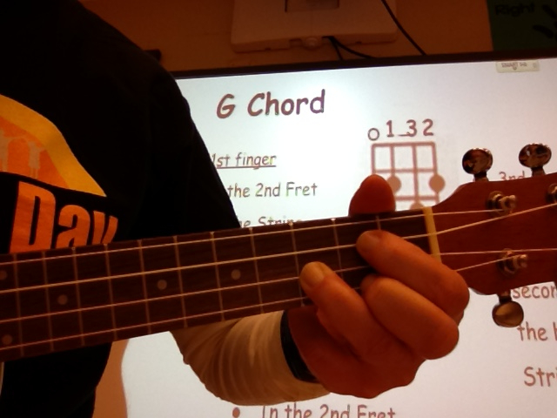

Slide 8
